Slide 1
What’s New in VMware vSAN 6.6?
DFW Mango Meetup 5/25/2017
Presented by Nick Korte (AKA NetworkNerd)
https://mangolassi.it/user/networknerd

Slide 3
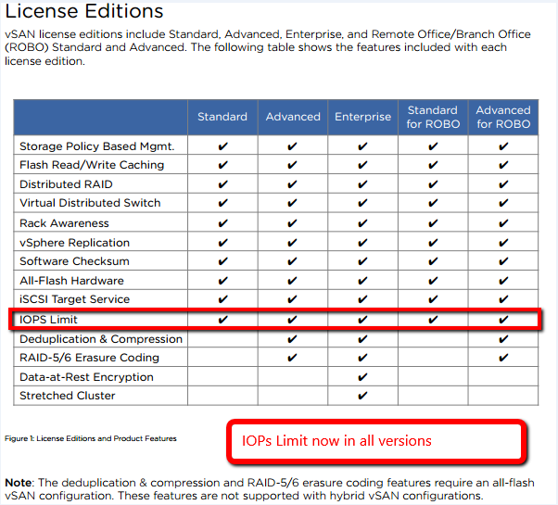
Getting to vSAN 6.6 – Buy the Licenses

Slide 4
Getting to vSAN 6.6
Requires vSphere 6.5d and compliant hardware
vSphere HCL vs vSAN HCL
Order of operations
vCenter to 6.5d
Hosts to 6.5d
Upgrade vSAN disk format to 5.0
Requires disk group evacuation or reduced redundancy
Insert upgrade story

Slide 5
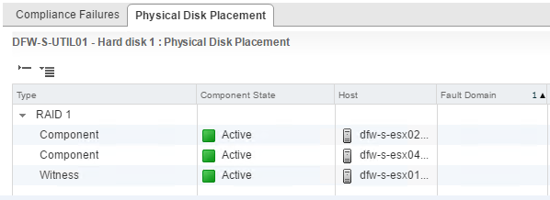
vSAN Terminology, Part 1
Disk group – 1 SSD for cache, 1 or more HDDs or SSDs
FTT – failures to tolerate
number of host, disk, or network failures a VM object can tolerate
n failures tolerated => n+1 copies of the VM object created and 2n+1 hosts with storage are required.
Components of a VMDK using RAID 1
Copy 1, copy 2, witness (all on different hosts in different fault domains)

Slide 6
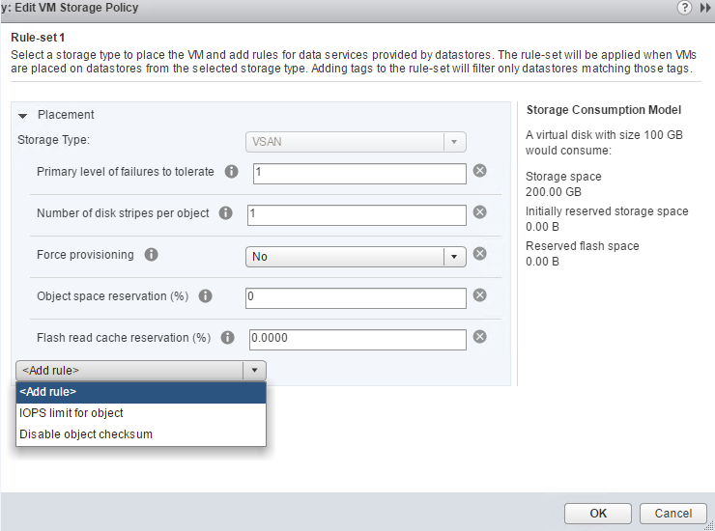
vSAN Terminology, Part 2
Storage policy – determines VMDK component placement / provisioning

Slide 7
Review of vSAN 6.5
GA in November 2016
vSAN was beta in 2013 and GA March 2014
Scales to 62TB VMDKs, 64 nodes, 35 capacity devices per node, 200 VMs per node
Up to 7m read-only 4K IOPS in a single 64-nodecluster (that's a lot!)
iSCSI Target Service
New and Improved PowerCLI Cmdlets
2-Node Direct Connect & Witness Separation
512e Storage Devices
Cloud Native Application Storage (i.e. Docker and Kubernetes)

Slide 8
vSAN 6.5 Requirements
Minimum 3 hosts (max 64)
Each host contributing storage to have minimum 1 HDD and 1 SSD
Hosts could have no storage and still leverage vSAN datastore
Layer 2 multicast must be enabled on the physical switch that handles vSAN traffic.
Each host must have minimum bandwidth dedicated to vSAN - 1 GbE for hybrid capacity, 10 GbE for all-flash capacity
In vSAN 6.5 hybrid cluster SSD will provide both a write buffer ( 30% ) and a read cache ( 70% ). The more SSD capacity in the host, the greater the performance since more I/O can be cached.
In vSAN all-flash cluster, 100% of the cache is allocated for writes, read performance from capacity flash is more than sufficient.
Only ESXi 6.0 U2 or later hosts can join a Virtual SAN 6.5 cluster.
vSAN storage provider created for each host when cluster is formed

Slide 9
vSAN 6.5
RAID 5 – needs 4 or more fault domains
RAID 6 – needs six or more fault domains

Slide 10
New in 6.6 – Easy Install
Baked into VCSA installer
See for yourself - video time!
Note: The video does not show configuration for NTP and SSO specific to each appliance

Slide 11
New in 6.6 – Goodbye Multicast!
vSAN uses only unicast starting with 6.6
Why the change?

Slide 12
New in 6.6 – vSAN Encryption
NOT the same as VM Encryption
Requires external KMS
Data is encrypted when it is written to persistent media in both the cache and capacity tiers of a vSAN datastore. Encryption occurs just above the device driver layer of the storage stack, which means it is compatible with all vSAN features (dedupe and compression, stretched cluster, etc.)
All vSphere features supported vs. only some with VM Encryption

Slide 13
New in 6.6 – Compliance Support
Support for 2-factor auth (RSA, CAC)
vSAN is part of vSphere STIG (Security Technical Implementation Guide)
Only DISA approved STIG for HCI
DISA = Defense Information Systems Agency

Slide 14
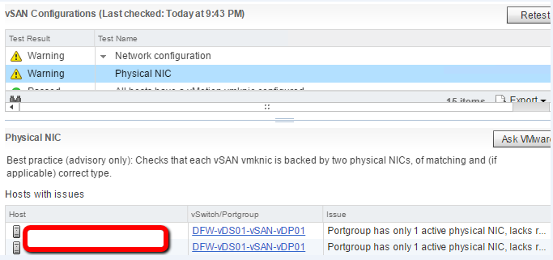
New to 6.6 – Config Assist / Cloud Health Checks
Learn to love CEIP

Slide 15
New in 6.6 – Hardware Lifecycle Management
Identify outdated firmware

Slide 16
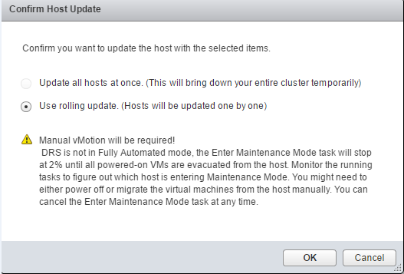
New in 6.6 – Hardware Lifecycle Management
Download and push updates within vCenter (some OEMs)

Slide 17
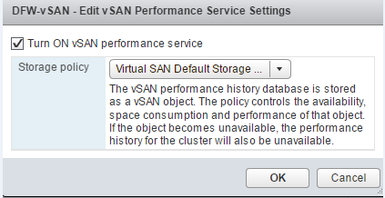
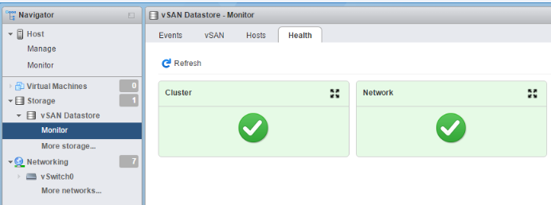
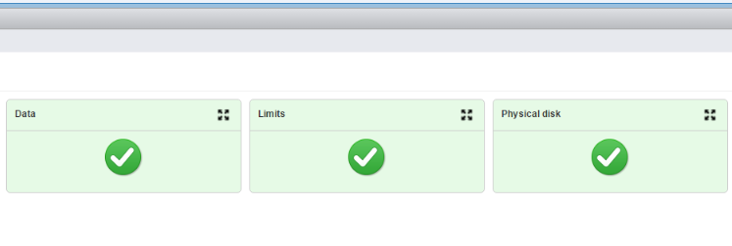
New to 6.6 – Highly Available Health Checks
Check cluster health from a specific host

Slide 18
New to 6.6 – vRealize Management Pack
Additional vSAN analytics
Monitoring and issue remediation
Licensing required

Slide 19
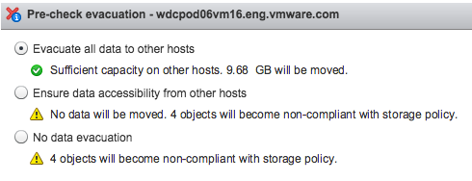
New to 6.6 – Host Evacuation
Built into maintenance mode
Used when removing a disk / disk group

Slide 20
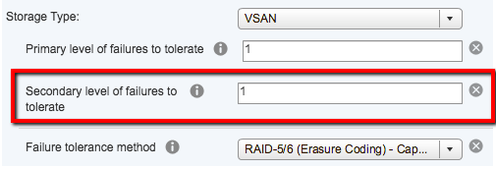
New to 6.6 – Stretched Cluster Local Failure Protection
Stretched clusters – introduced in 6.0
Storage redundancy within and across sites

Slide 21
New to 6.6 – Stretched Cluster Site Affinity
Keep VMs at specific site only
No cross-site redundancy

Slide 22
New to 6.6 – Degraded Device Handling
When failure of a device is anticipated, vSAN evaluates the data on the device. If there are replicas of the data on other devices in the cluster, vSAN will mark these components as “absent”. “Absent” components are not rebuilt immediately as it is possible the cause of the issue is temporary. vSAN waits for 60 minutes by default before starting the rebuild process. This does not affect the availability of a VM as the data is still accessible using one or more other replicas in the cluster. If the only replica of data is located on a suspect device, vSAN will immediately start the evacuation of this data to other healthy storage devices.

Slide 23
New to 6.6 – Misc.
All-flash vSAN 6.6 performs 50% better than in vSAN 6.5
Improvements to vSAN API and PowerCLI commands (performance monitoring, cluster upgrades, vSAN iSCSI operations)
Improved component rebuild – repair after 60 mins, most efficient method

Slide 24
New to 6.6 – Misc.
Intelligent rebalance
Can throttle resync operations at cluster level

Slide 25
Additional Resources
VMware Storage Hub - https://storagehub.vmware.com/
Virtual Blocks Blog - https://blogs.vmware.com/virtualblocks/
Duncan Epping’s Blog – www.yellow-bricks.com
Virtually Speaking Podcast - https://soundcloud.com/virtuallyspeakingpodcast
VMUG Advantage Membership ($200) - https://www.vmug.com/VMUG-Join/VMUG-Advantage

