Slide 1
If vSAN Powered The Matrix
[VMTN6733U]
Presented by Nick Korte @NetworkNerd_

Slide 2
Disclaimer
This presentation may contain product features or functionality that are currently under development.
This overview of new technology represents no commitment from VMware to deliver these features in any generally available product.
Features are subject to change, and must not be included in contracts, purchase orders, or sales agreements of any kind.
Technical feasibility and market demand will affect final delivery.
Pricing and packaging for any new features/functionality/technology discussed or presented, have not been determined.
This information is confidential.

Slide 3
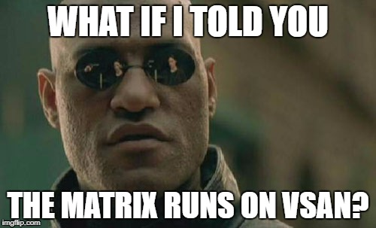

Slide 4
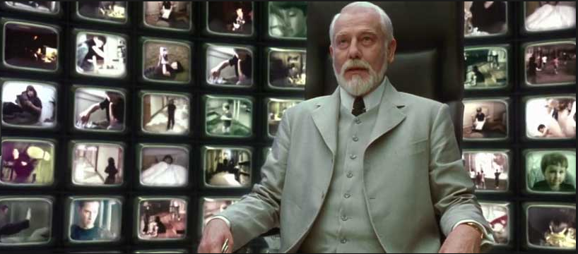
The Fatal Flaw in Architecture

Slide 5
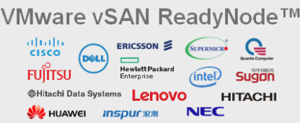
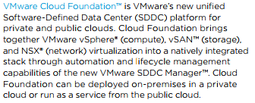
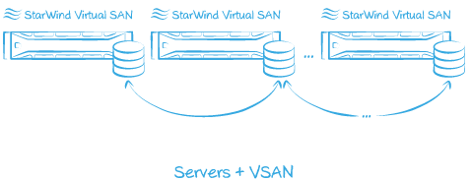
The Problem Is Choice
Today’s challenges

Slide 6
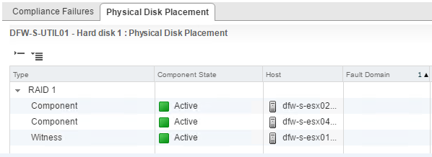
Taking the Red Pill – Down the Rabbit Hole
Disk group – 1 SSD for cache, 1 or more HDDs or SSDs
FTT – failures to tolerate
number of host, disk, or network failures a VM object can tolerate
n failures tolerated => n+1 copies of the VM object created and 2n+1 hosts with storage are required.
Components of a VMDK using RAID 1
Copy 1, copy 2, witness (all on different hosts in different fault domains)

Slide 7
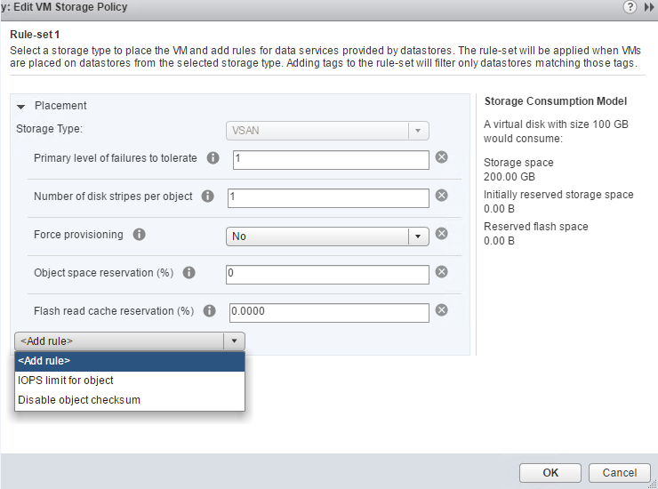
Further Down the Rabbit Hole
Storage policy – determines VMDK component placement / provisioning

Slide 8
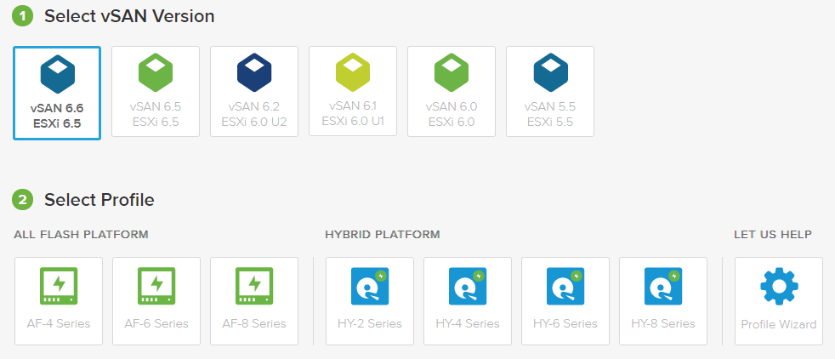
vSAN Ready Nodes, Part 1
Today’s challenges
vSAN ReadyNode Configurator - http://vsanreadynode.vmware.com/RN/RN

Slide 9
vSAN Ready Nodes, Part 2
Today’s challenges

Slide 10
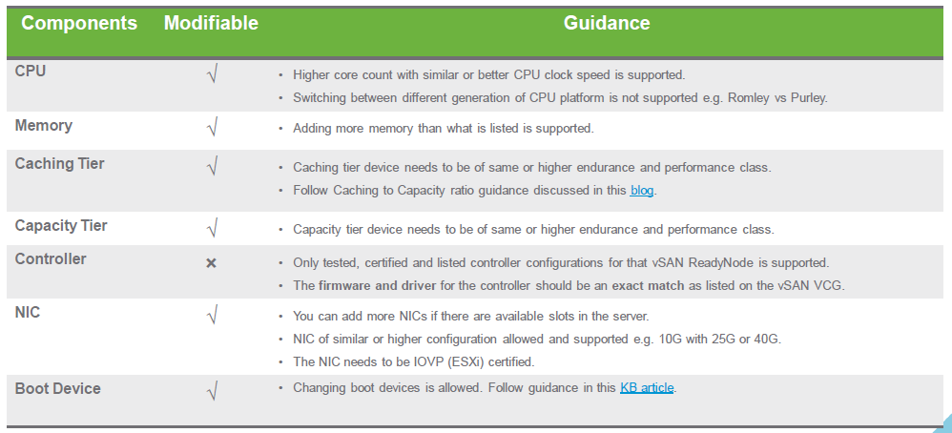
vSAN Ready Nodes, Part 3
Today’s challenges
Essential Guide to vSAN ReadyNodes - https://portal.inxpo.com/ID/VMWare/12/

Slide 11
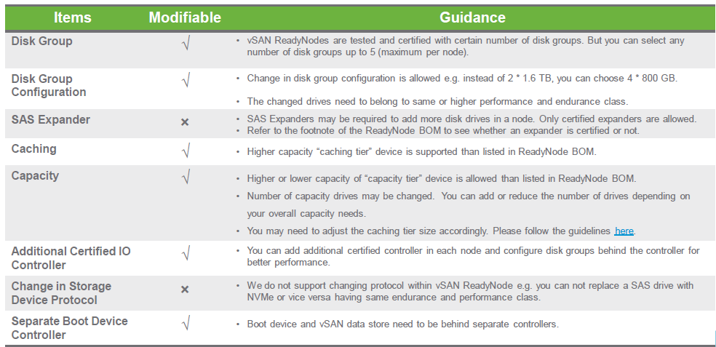
vSAN Ready Nodes, Part 4
Today’s challenges
Essential Guide to vSAN ReadyNodes -
https://blogs.vmware.com/virtualblocks/2017/03/14/can-cannot-change-vsan-readynode/

Slide 12
Capacity Planning
vSAN Hybrid TCO and Sizing Calculator - https://vsantco.vmware.com/vsan/SI/SIEV
All Flash vSAN ReadyNode Sizer - https://vsansizer.vmware.com/vsansizing/html/dcScaleDeploymentsOptions.html
vSAN HCL - https://www.vmware.com/resources/compatibility/search.php?deviceCategory=vsan
Memory overhead for hosts – VMware KB 2113945

Slide 13
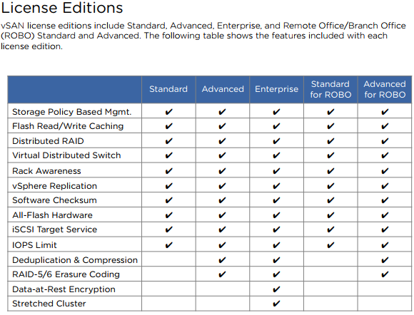
Licensing, Part 1
Today’s challenges

Slide 14
Licensing, Part 2
Today’s challenges
Added vSAN Enterprise for ROBO to enable the use of native encryption and stretched clusters on a per-VM pricing model for smaller sites
For customers that are benefiting from vSAN Advanced being included with Horizon ADV and ENT bundles, we now offer a simple upgrade path to vSAN Enterprise for organizations that want encryption and stretched clusters in a Horizon VDI environment.

Slide 15
Networking, Part 1
Today’s challenges
Hybrid
Dedicated 1 GbE supported but 10 GbE recommended, < 1 ms RTT
All-flash
Dedicated or shared 10 GbE required, < 1 ms RTT
Jumbo frames to reduce CPU utilization?
vSphere HA Considerations
Using vSAN network, disable host monitoring before making changes to vSAN networking
Need VMkernel port for vSAN
Multiple uplinks, recommended to use link aggregation / LACP and vDS

Slide 16
Networking, Part 2
Today’s challenges
Stretched clusters
Data to data, < 5 ms RTT, 10 Gb between sites required
Witness to data, < 200 ms RTT, 100 Mbps connectivity at data sites to witness`
No more multicast in vSAN 6.6 / 6.6.1
vSAN Network Design Guide - https://storagehub.vmware.com/export_to_pdf/vmware-r-vsan-tm-network-design

Slide 17
Storage Policies
Today’s challenges
RAID 1 – need 3 or more fault domains with FTT =1
RAID 5 – need 4 or more fault domains with FTT = 1
RAID 6 - need 6 or more fault domains with FTT = 2
No support for RAID 5/6 in stretched clusters

Slide 18
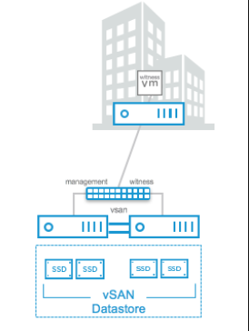
Topologies for a Small RAID 1 vSAN Cluster
Today’s challenges
Starts with 2 Nodes
Needs witness with
< 500 ms RTT, 1.5 Mbps
bandwidth
Better – 3 nodes
Best – 4 or more nodes

Slide 19
Security and Compliance
Today’s challenges
vSAN Encryption – for data at rest
https://blogs.vmware.com/virtualblocks/2017/04/11/vsan-6-6-native-data-at-rest-encryption/
vSAN Enterprise license
VM Encryption – per VM, encrypted vMotion
https://docs.vmware.com/en/VMware-vSphere/6.5/com.vmware.vsphere.security.doc/GUID-B3DA9865-A28F-4EFD-ACF4-CBC8813ED110.html
vSphere Enterprise Plus license
Need external KMS for both
DON’T ENCRYPT THE VCSA!!!!!

Slide 20
Firmware Matters
Today’s challenges
Identify Outdated firmware, and take action (certain OEMs)
Dell, Fujitsu, Lenovo, Supermicro – updates identified through VUM

Slide 21
New to vSAN 6.6 / 6.6.1
Today’s challenges
Config Assist
Easy Install – baked into VCSA installer
Stretched cluster local failure protection

Slide 22
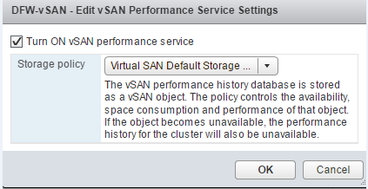
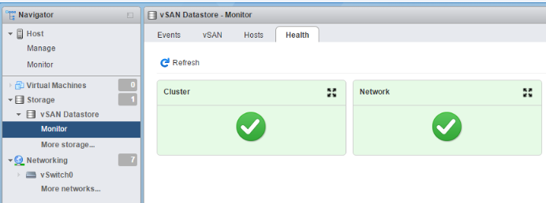
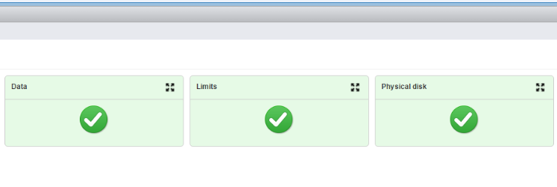
New to vSAN 6.6 / 6.6.1
Today’s challenges
Highly Available Health Checks

Slide 23
In Summary
What is Permissible
Licensing - think single-socket ReadyNodes
Size the cache appropriately (hybrid vs. flash)
Plan for memory overhead just for vSAN
Use 10GbE networking
Plan for storage capacity appropriately
Use latest version of vSphere
Upgrade in proper order

Slide 24
Helpful vSAN Resources
What is Permissible
VMware Storage Hub - https://storagehub.vmware.com
Virtually Speaking Podcast - http://www.vspeakingpodcast.com
vSAN 6.6 Licensing Guide - https://blogs.vmware.com/virtualblocks/2017/05/12/vmware-vsan-6-6-licensing-guide/
vSAN ReadyLabs - https://blogs.vmware.com/virtualblocks/2017/05/22/look-vsan-readylabs-powers-largest-choice-hci-hardware/
Virtually Speaking Podcast # 51

Slide 25
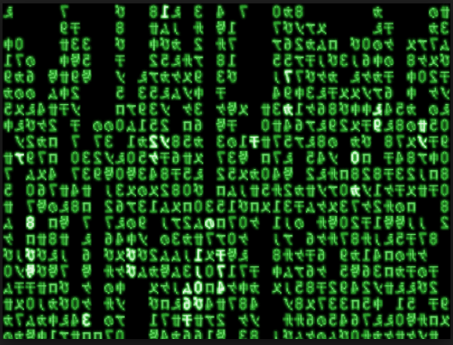
Thank You!
What is not Permissible
Twitter - @NetworkNerd_
Blog – http://blog.thenetworknerd.com
Spiceworks - https://community.spiceworks.com/people/networknerd

