Slide 1
Coming out of the Shadows
The IT Manager’s Guide to Shadow IT Prevention

Slide 2
Network and Systems Engineer
Staff One HR
12 / 2016 – Present
Systems Administrator
Manufacturing Industry
12 / 2007 – 12 / 2016
SW Community Name: NetworkNerd
Twitter: @NetworkNerd_
Blog: http://blog.thenetworknerd.com
Nick Korte
Staff One HR

Slide 3
Let’s Make This Interactive
Tweet your questions to #SW2017ShadowIT

Slide 4
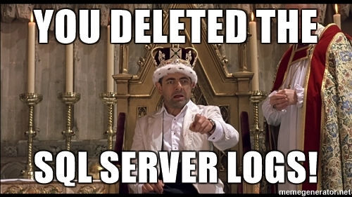
A Series of Unfortunate Events, Part 1
One afternoon, the ERP system came to a screeching halt…
SQL Server was still running…
And the root cause goes to…
Notes:
The ERP system in question here was running on its own VM with SQL Server on a different VM.

Slide 5
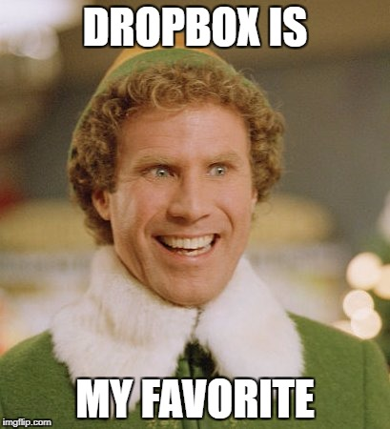
A Series of Unfortunate Events, Part 2
Meet Stephen, Sales guy for XYZ, Inc.
Stephen’s computer is slow
Stephen loves Dropbox
And when Stephen left XYZ, Inc…

Slide 6
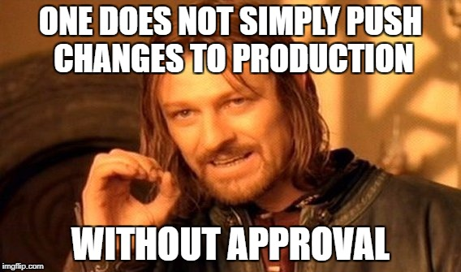
A Series of Unfortunate Events, Part 3
Trusted vendor ABC has VPN access…
Vendor is helping department lead with something in DEV
Changes were pushed to PROD

Slide 7
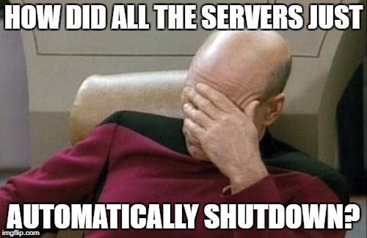
A Series of Unfortunate Events, Part 4
Small Fry, Inc. has a MSP that helped setup a few new VM hosts
The MSP also setup a graceful shutdown solution
The MSP is later fired
The UPS battery life starts to decrease
Then one day…

Slide 8
Defining Shadow IT
Wikipedia says… Technology projects implemented within an organization outside of (and likely without the knowledge of) the Information Technology (IT) department .
But I already knew that…so who cares?
You should care
Your boss should care
End users should care
The executive team should care
The hackers care
Notes:
This all started with a blog post - https://www.staffone.com/avoid-threat-shadow-it-tech-policies/

Slide 9
Failure Is Really the Problem
IT’s role is to use technology to enable the business
Reasons we fail
Speed to implement
Lack of knowledge
Lack of staff
Lack of budget
Management buy-in
Just an afterthought
Company size

Slide 10
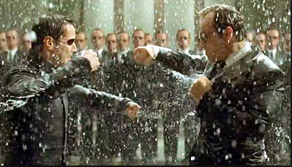
The Shadow IT Umbrella
Two main categories
All Other Threats to the Free World
End Users

Slide 11
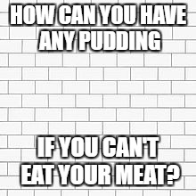
Ready to Begin?
Observe before You Change
Gradual Small Changes
Don’t Eat the Elephant

Slide 12
Keeping Users Honest, Part 1
Be a User Advocate
Understand their perspective
Leverage beta testers
Take their suggestions to heart
Hide behind management
Communicate changes
Monitor Everything
Inventory software and hardware – Spiceworks, Sodium Suite, PRTG, Kaseya, etc.
Least Privilege Access

Slide 13
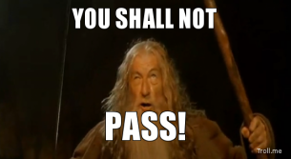
Keeping Users Honest, Part 2
Admin Rights, Anyone?
Good – Power Users / Users only
Better – Software Restriction Policies
Best – Good + Better + Software Patching
Alternatives…?
Make Friends in Other Departments
Onboarding and Termination Procedures - HR
Corporate Software Policy - HR
Leverage Compliance – QA
Audit the Bills - Finance

Slide 14
Prevent Shadow IT from Everyone Else
Practice JITJEA
Just in time, just enough admin
Internal IT staff, Consultants, Developers
SQL, AD, E-mail / Spam Filter, Hypervisor, Cryptography Mgmt, Backup Management, etc.
Syslog
PRTG, Kiwi, Loggly, vRealize Log Insight, etc.
SIEM (Security Information and Event Management)
AlienVault, Arctic Wolf, OSSIM (free)
Change Management

Slide 15
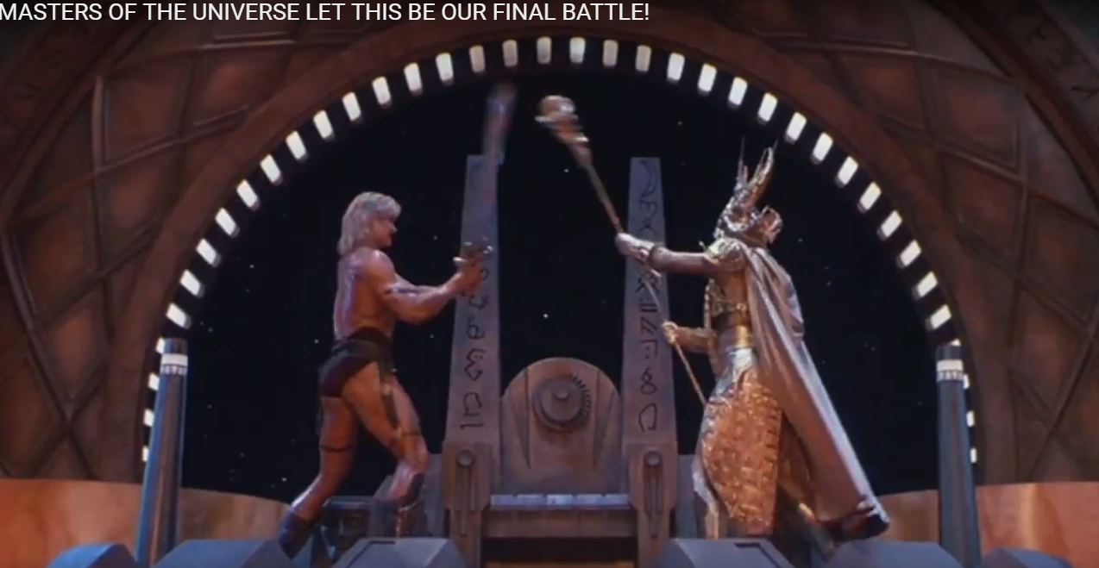
Management - You vs. Them

Slide 16
Sell Your Idea
Start with your boss
What keeps him / her up at night?
What keeps his / her boss up at night? Repeat until you reach the C-level.
Be a unicorn
Know when to make a less technical pitch
What business problem are you solving?
Focus on organizational improvements – decrease in risk, bring into compliance, reduction of potential fines, more security with better user experience, etc.

Slide 17
Additional Resources
Jeffrey Snover on JEA and Powershell https://channel9.msdn.com/Events/TechEd/NorthAmerica/2014/DCIM-B362
Datanauts Episode 57: Thinking At The C-Level http://packetpushers.net/podcast/podcasts/datanauts-057-thinking-c-level/
Datanauts Episode 101: CIOs And The Business Side Of IT http://packetpushers.net/podcast/podcasts/datanauts-101-the-business-side-of-it/
The blog post that started it all - https://www.staffone.com/avoid-threat-shadow-it-tech-policies/

Slide 18
ANY Questions? #SW2017ShadowIT

Slide 19
Thank You!

