Slide 1
If vSAN Powered The Matrix
Nick Korte
@NetworkNerd_
Solution Engineer, VMware
October 2, 2018

Slide 2
The First Iteration…
VMworld 2017 US
vBrownBag Session VMTN6733U
http://blog.thenetworknerd.com/2017/09/04/if-vsan-powered-the-matrix

Slide 3
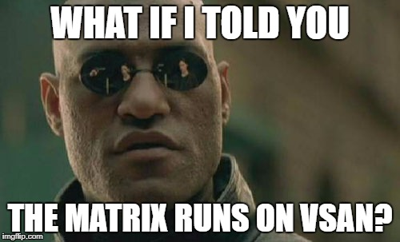

Slide 4
The Fatal Flaw in Architecture
Notes:
NEO said “the problem is choice.”
His choices were two doors – one to save Trinity and destroy the human race, another to go to the Source and choose a certain number of survivors

Slide 5
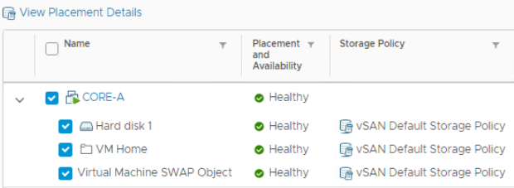
Taking the Red Pill – Down the Rabbit Hole
Disk group – 1 SSD for cache, 1 or more HDDs or SSDs for capacity
FTT – failures to tolerate
number of host, disk, or network failures a VM object can tolerate
n failures tolerated => n+1 copies of the VM object created and 2n+1 hosts with storage are required.
Components of a VMDK using RAID 1
Copy 1, copy 2, witness (all on different hosts in different fault domains)
Notes:
Object Types:
VM Home = home directory where all config files are stored (VMX, log files, snapshot delta description files), all metatdata for the VM
VMDK
VM Swap Object = created when VM powered on (RAM, if thin provisioned)
Max component size Is 255 GB

Slide 6
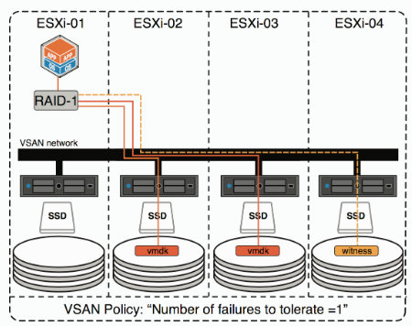
Quick vSAN Vizualization

Slide 7
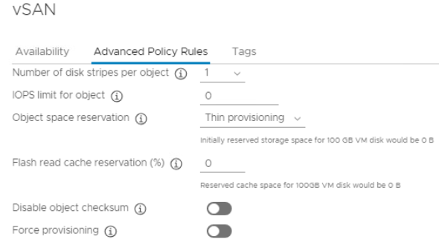
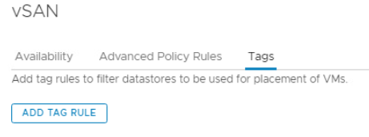
Further Down the Rabbit Hole with Storage Policies
Storage policy – determines VMDK component placement / provisioning
Notes:
Stripes per object = number of capacity disks touched, each stripe considered a component
vSAN datastore available to all hosts in the cluster, even if they do not contribute storage
Hybrid = 70/30 Read/Write cache
All-Flash = reads served directly from capacity tier unless block has not been destaged
Flash cache reservation only for hybrid
Stretched clusters do allow data locality
IOPs limit = limits number of IOPs a vSAN object may use.

Slide 8
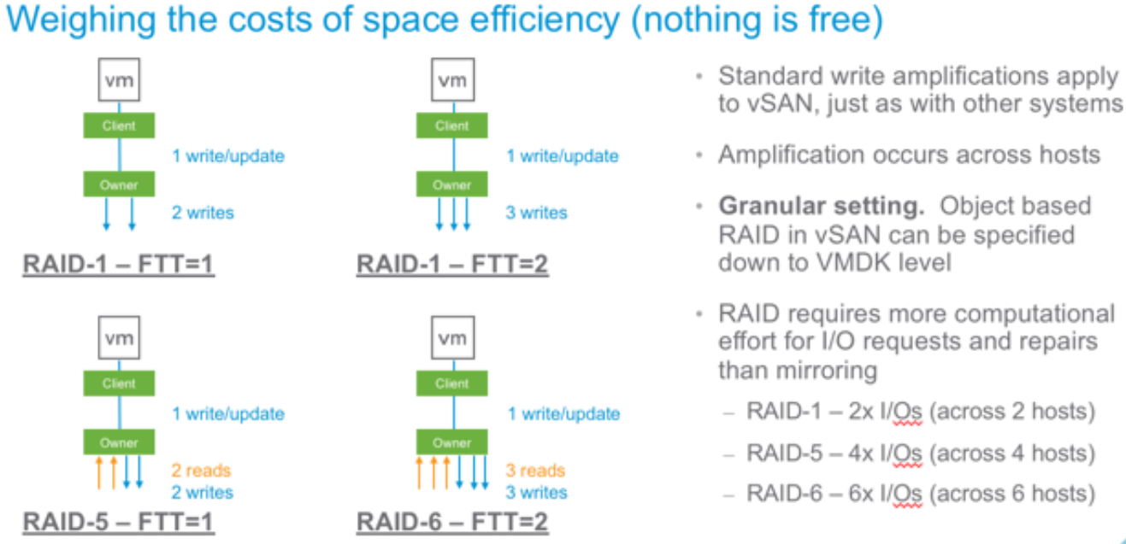
Storage Policies, Continued
RAID 1 – need 3 or more fault domains with FTT =1 (2 times the space required)
RAID 5 – need 4 or more fault domains with FTT = 1 (1.3 times the space required)
RAID 6 - need 6 or more fault domains with FTT = 2 (1.5 times the space required)
Stretched cluster local protection can be RAID 5/6

Slide 9
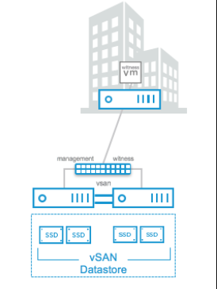
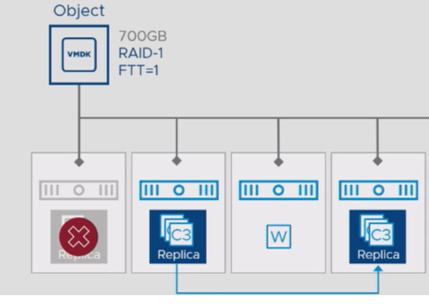
Topologies for a Small RAID 1 vSAN Cluster
Starts with 2 nodes
Needs witness with < 500 ms RTT, 1.5 Mbps bandwidth
Direct connect or through switched infrastructure
Better – 3 nodes
Best – 4 nodes
Notes:
vSAN Witness hosted on another vSAN (supported) – for example, remote site with witness at main DC
Witness is just an appliance but acts as another host

Slide 10
Security and Compliance
vSAN Encryption – for data at rest
https://blogs.vmware.com/virtualblocks/2017/04/11/vsan-6-6-native-data-at-rest-encryption
vSAN Enterprise license
VM Encryption – per VM, encrypted vMotion
https://docs.vmware.com/en/VMware-vSphere/6.5/com.vmware.vsphere.security.doc/GUID-B3DA9865-A28F-4EFD-ACF4-CBC8813ED110.html
vSphere Enterprise Plus license
Need external KMS for both
DON’T ENCRYPT THE VCSA!!!!!
Notes:
Cryptographic modules are FIPS compliant
Talk about the self-encrypting drives

Slide 11
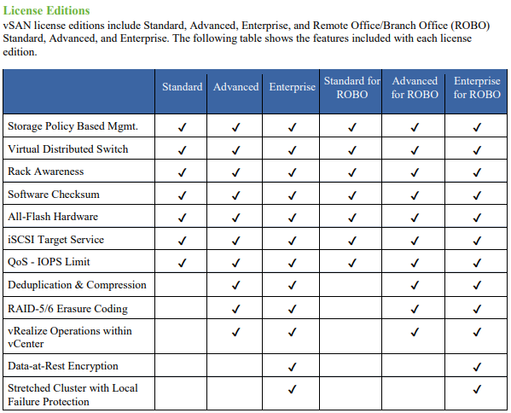
Licensing, Part 1
Notes:
Hit on iSCSI service as a way to connect external systems
Possible to have a compute only node
Mention local failure protection

Slide 12
Licensing, Part 2
vSAN Advanced comes with Horizon Advanced / Enterprise
Easy add-on upgrade to vSAN Enterprise (encryption, stretched clusters)
vSAN for Desktop Standard / Advanced / Enterprise
Licensed per concurrent user for VDI (not just Horizon) – 10 or 100 packs
vSAN ROBO limited to 25 VMs at any single location
Get the vSAN 6.7 licensing guide here - https://www.vmware.com/content/dam/digitalmarketing/vmware/en/pdf/products/vsan/vmware-vsan-67-licensing-guide.pdf

Slide 13
Networking, Part 1
Hybrid
Dedicated 1 GbE supported
10 GbE recommended if shared with other network traffic types
All-flash
Dedicated or shared 10 GbE required, < 1 ms RTT
Consider 25 GbE
Use NIOC (requires vDS)
Jumbo frames to reduce CPU utilization?
vSphere HA Considerations
Using vSAN network, disable host monitoring before making changes to vSAN networking
Need VMkernel port for vSAN
Multiple uplinks, consider link aggregation / LACP and vDS
Notes:
This is for the vSAN network specifically
Use NIOC to ensure no traffic type takes up entire pipe
vSAN supports jumbo frames. VMware testing finds that using jumbo frames can reduce CPU utilization and improve throughput. The gains are minimal because vSphere already uses TCP Segmentation Offload (TSO) and Large Receive Offload (LRO) to deliver similar benefits.
In data centers where jumbo frames are already enabled in the network infrastructure, jumbo frames are recommended for vSAN deployment. Otherwise, jumbo frames are not recommended as the operational cost of configuring jumbo frames throughout the network infrastructure typically outweigh the benefits.
LACP can improve performance and bandwidth and gives network adapter redundancy
Dynamic link aggregation / LACP with source and destination IP addresses, TCP / UDP port and VLAN
LACP with IP-Hash policy
vSphere HA uses the management network only when vSAN is disabled. vCenter Server chooses the appropriate network when vSphere HA is configured on a host.

Slide 14
Networking, Part 2
Stretched clusters
Data to data, < 5 ms RTT, 10 Gb between sites required
Witness to data, < 200 ms RTT, 100 Mbps connectivity at data sites to witness
No more multicast as of vSAN 6.6 / 6.6.1
vSAN Network Design Guide - https://storagehub.vmware.com/export_to_pdf/vmware-r-vsan-tm-network-design

Slide 15
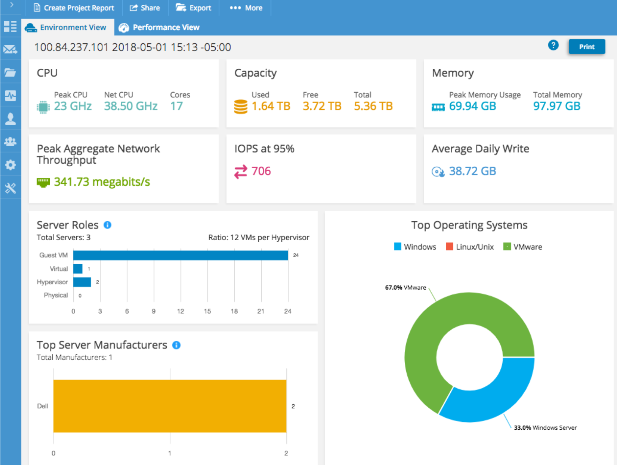
Architecting vSAN for Performance – Profiling
When should you profile workloads?
Tools to help with profiling
LiveOptics vSAN Assessment (LOVA)
https://app.liveoptics.com/register/vmware
RV Tools
Others…?
Notes:
LiveOptics – 24 – 48 hours

Slide 16
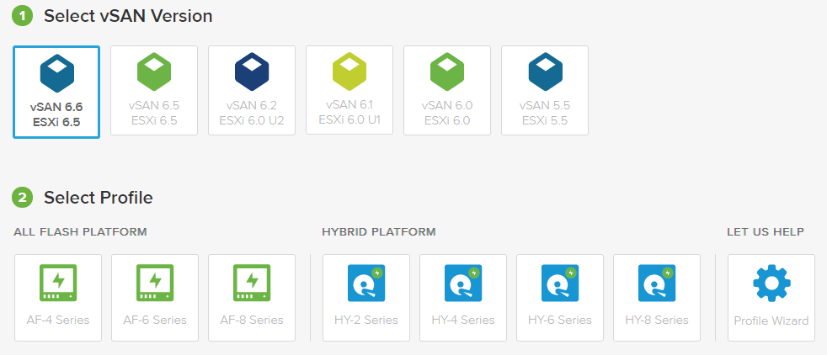
vSAN Ready Nodes, Part 1
vSAN ReadyNode Configurator - http://vsanreadynode.vmware.com/RN/RN

Slide 17
vSAN Ready Nodes, Part 2

Slide 18
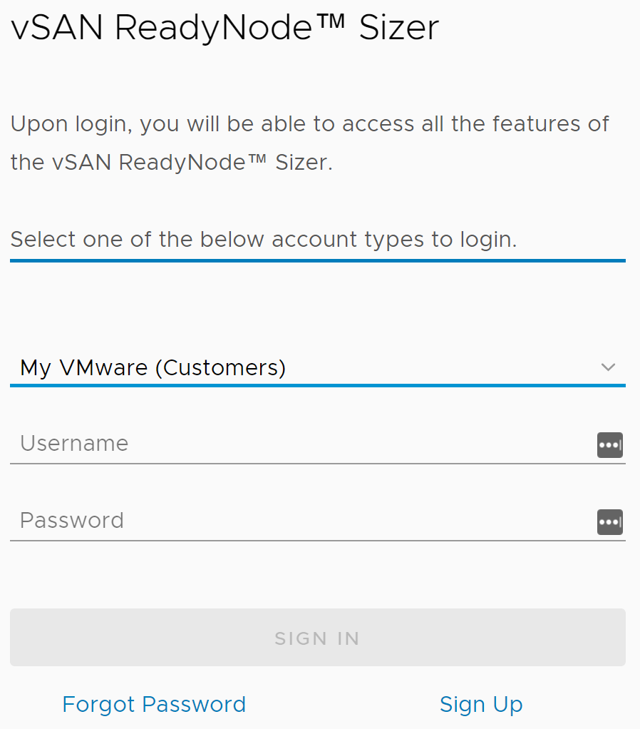
vSAN Workload Sizing Tool, Part 1
vSAN Sizing Tool (All Flash / Hybrid) - http://vsansizer.vmware.com

Slide 19
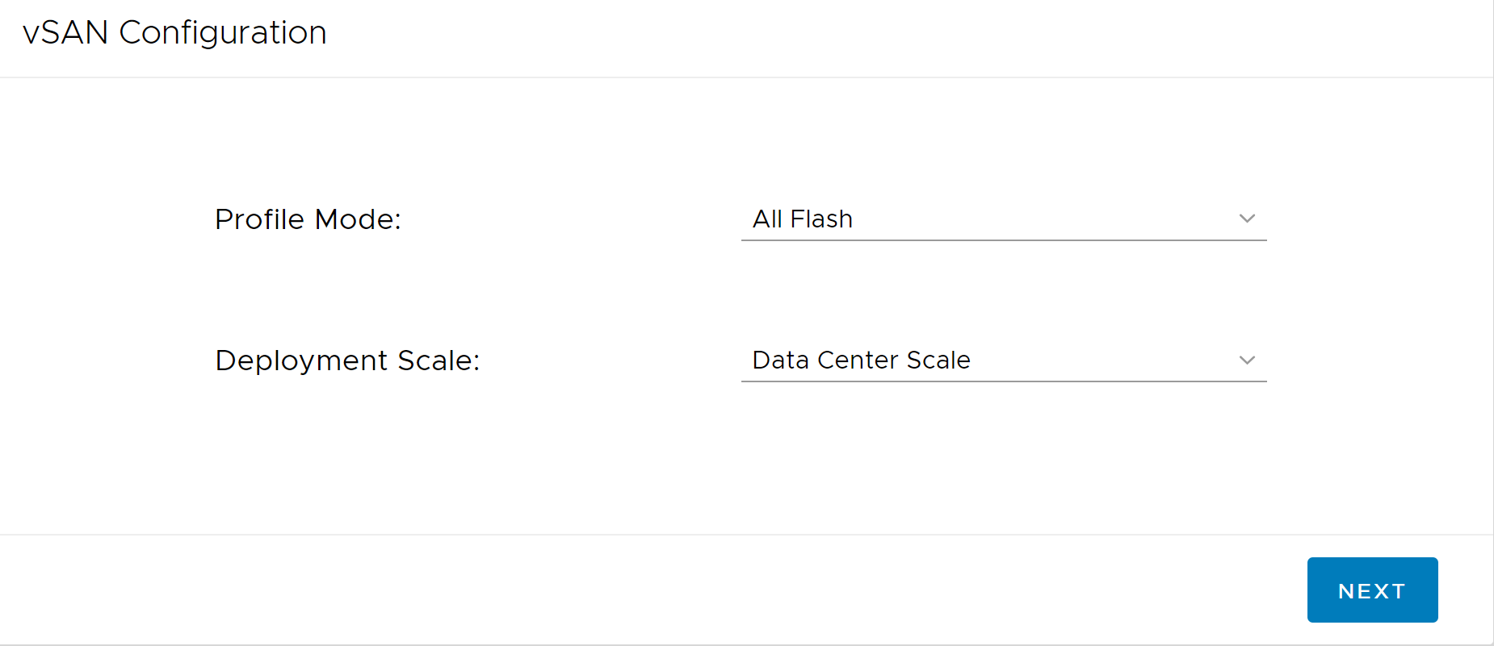
vSAN Workload Sizing Tool, Part 2 – All Flash / Hybrid
Notes:
Profile mode – all flash / hybrid
Deployment scale – data center scale

Slide 20
vSAN Workload Sizing Tool, Part 3 – Use Case
Notes:
Workload Choices are General Purpose, Database (Oracle / SQL), VDI
Option to import RV Tools Feed here

Slide 21
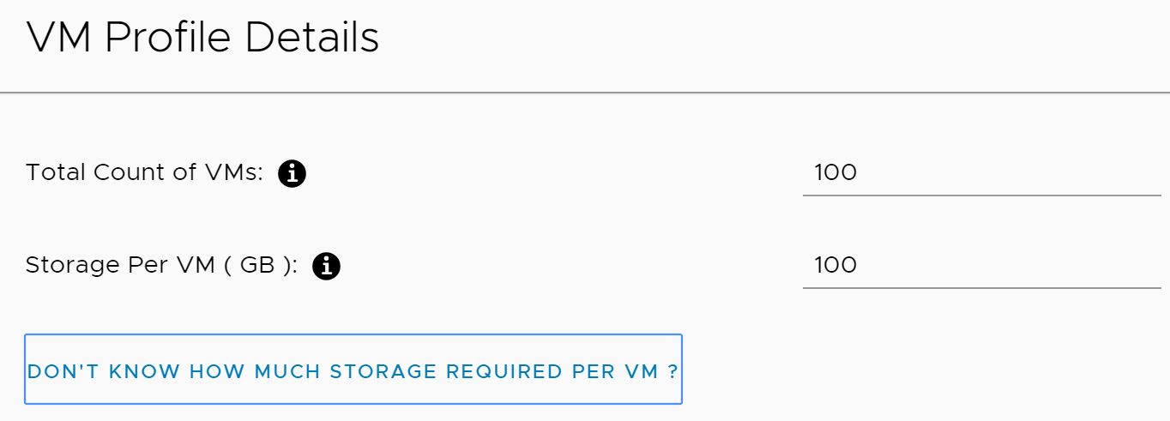
vSAN Workload Sizing Tool, Part 4 – VM Profile
Notes:
Option to put in total storage for entire cluster

Slide 22
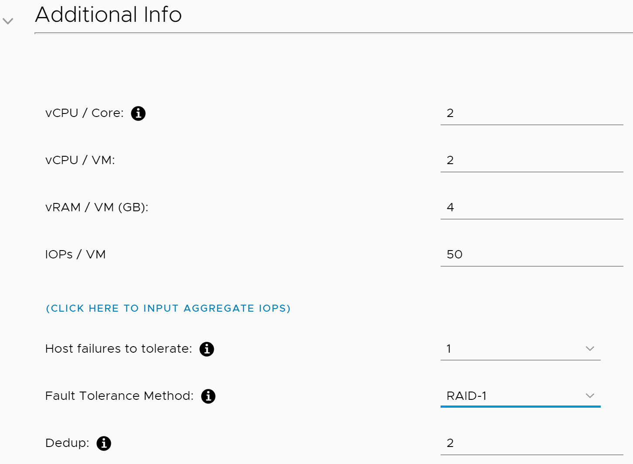
vSAN Workload Sizing Tool, Part 5 – Additional Info
Notes:
Advanced settings allow selection of a resource utilization plan (VM utilization, resource utilization, etc.)

Slide 23
vSAN Workload Sizing Tool, Part 6 – IO Profile
Notes:
Random / sequential
4 KB, 8 KB, 16 KB
IO Ratio – 70/30, 80/20, 90/10, 50/50

Slide 24
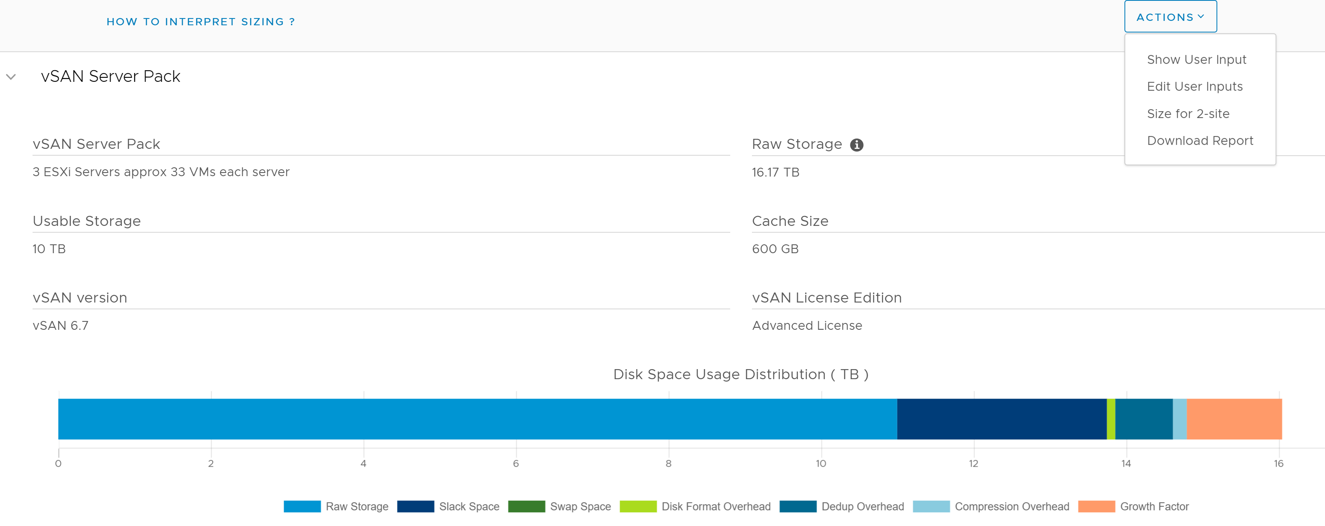
vSAN Workload Sizing Tool, Part 7 – vSAN Server Pack

Slide 25
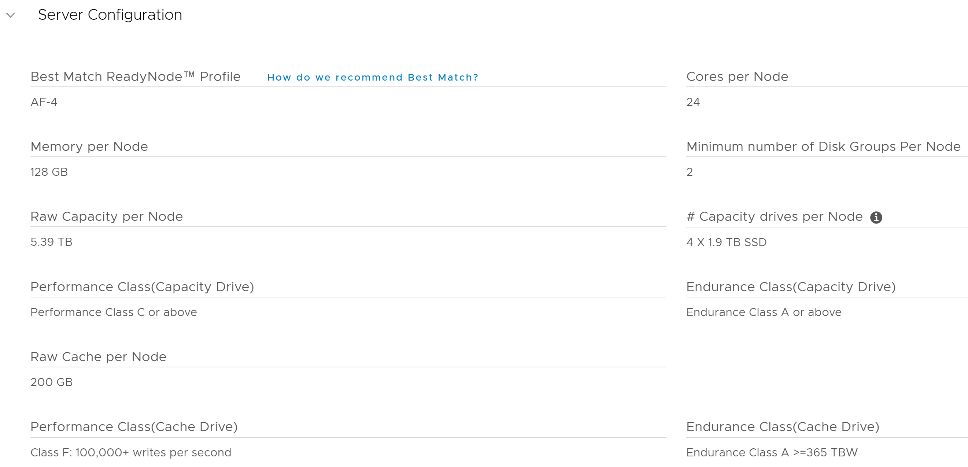
vSAN Workload Sizing Tool, Part 8 – Server Configuration
Notes:
Random / sequential
4 KB, 8 KB, 16 KB
IO Ratio – 70/30, 80/20, 90/10, 50/50

Slide 26
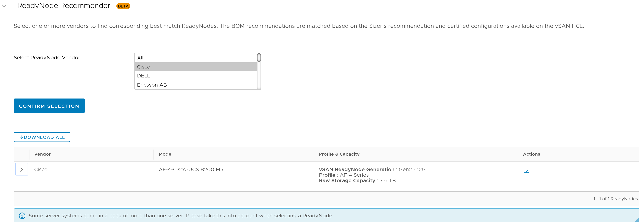
vSAN Workload Sizing Tool, Part 9 – ReadyNode Recommender
Notes:
See assumptions section below this. For example, assumes 24 drives per server, max memory per server, CPU clock speed

Slide 27
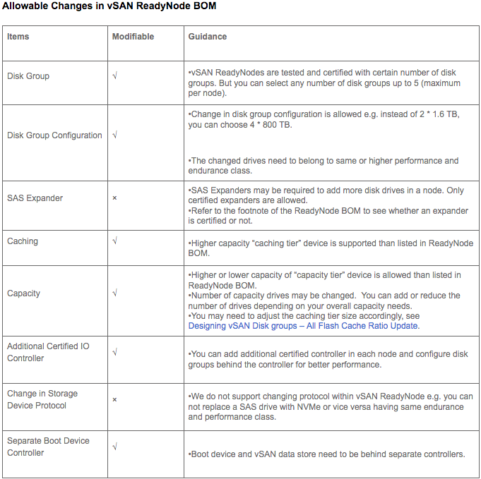
Making Changes to a ReadyNode
https://kb.vmware.com/s/article/52084
Disk Controller – Firmware and Driver must be on VCG
SAS Expander – Only certain expanders allowed
Storage Device Protocol – NVMe drive cannot replace SAS SSD and vice versa
Notes:
Essential Guide to vSAN ReadyNodes - https://portal.inxpo.com/ID/VMWare/12/

Slide 28
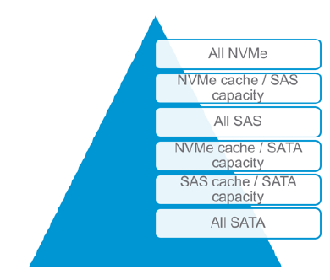
Architecting vSAN for Performance - Hardware
All-flash - more predictable and responsive than hybrid
SATA protocol is 1-to-1. Lock bus used to send commands to and from controller. Avoid if possible.
Storage controllers can be a bottleneck. Additional controllers may help, especially in all-flash.
Limited support of SAS expanders to minimize performance or availability issues
NVMe – fastest, simple (no external controller), and low CPU overhead compared to SATA / SAS
Firmware matters!

Slide 29
Architecting vSAN for Performance – Additional Tricks
Make servers building blocks
Standardize compatible BIOS versions
Start with minimal 2 disk groups
In the BIOS…
Turn off processor C-states
Set to max performance power profile (if applicable)
Plan for vSAN memory overhead
See KB 2113954
Prep the storage controller
HBA330 over PERC for Dell
Notes:
Selecting a high-performance policy provides more absolute performance, but at lower efficiency and performance per watt. Low-power policies provide less absolute performance, but at higher efficiency.
Share the story about someone who scripted a power management policy change when hosts went to UPS

Slide 30
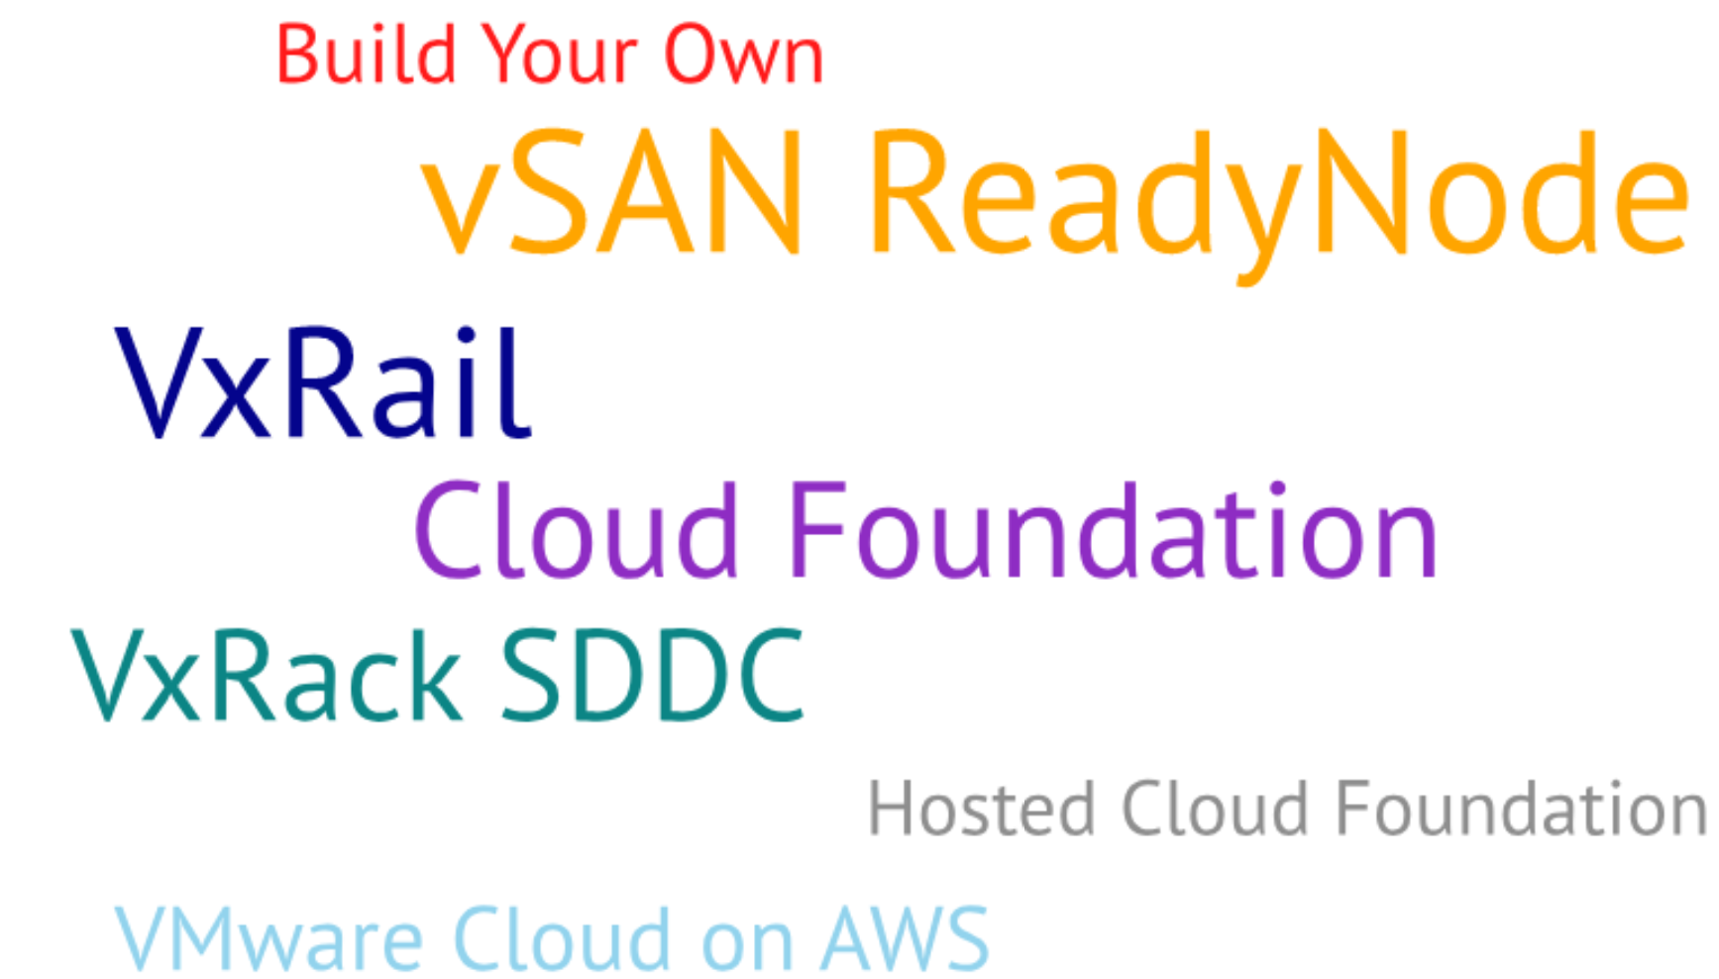
Let’s Talk Career
Can implementing vSAN change your career?
The problem is choice.

Slide 31
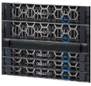
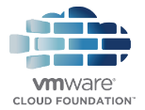
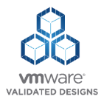
Accelerating IT Transformation
Hybrid Cloud
Integrated SDDC Platform
VMware Cloud on AWS
Validated SDDC Design
SDDC
HCI
VMware Cloud Providers
Cloud Maturity
vSAN Ready Nodes
BYO
Data Center Modernization
Private Cloud
Public Cloud
Speed to Cloud
Notes:
BYO
You can certainly build your own software-defined data center using best of breed modern infrastructure. Leveraging hyper-converged infrastructure can get you there faster and easier.
VxRail platform
With VxRail, our leading HCI solution and the only vSAN-powered appliance jointly engineered with VMware, ongoing innovation continues this year at Dell Technologies World to include leading edge technologies that make VxRail even more flexible and powerful, eliminate the need for lengthy evaluation cycles, and enable IT to focus on strategic transformation. VxRail continues to set the standard for simplifying and modernizing VMware environments, regardless of where an organization starts or ends their IT transformation.
Validated SDDC Design – VMware Validated Designs
And now, VxRail offers an even simpler path to the cloud. For customers looking to build a complete Software-Defined Data Center using VxRail as a building block, they can now leverage guidance of the latest version of VMware Validated Designs to reduce risk and simplify operations and maintenance by building a validated, standardized SDDC design that is based on VMware’s best practices.
Integrated SDDC Platform – VMware Cloud Foundation
For customers looking for a service-oriented IT model with the fastest and easiest path to hybrid cloud, VxRack SDDC is the most advanced VMware Cloud Foundation engineered system. Delivering a complete, turnkey, rack-scale HCI system for VMware SDDC – from virtualized compute, storage and networking to the complete set of cloud management capabilities. We have seen great momentum with VMware Cloud Foundation and VxRack SDDC, with customers across all Geos and Industry Verticals adopting this platform for a variety of use cases. From fundamentally modernizing their infrastructure by fully virtualizing compute, storage and networking, to enabling Infrastructure as a Service on a Software-Defined Private Cloud.
Hybrid Cloud
Realizing the VMware multi-cloud vision means to build a single, consistent hybrid cloud experience – one that is built on a simple, powerful, secure platform that can span across multiple clouds. It means application extensibility and compatibility across private and public clouds. And it means a platform that can support both traditional VMs and newer cloud native applications and containers.

Slide 32
vSAN Feature List vs. vSphere Version
https://storagehub.vmware.com/t/vmware-vsan/vsan-features-vs-vsphere-version/vsan-feature-list-1/
Notes:
Windows Server Failover Clustering

Slide 33
Helpful vSAN Resources, Part 1
VMware Storage Hub - https://storagehub.vmware.com
Reference Architecture Guides – SQL, MySQL, SAP, Oracle, Horizon, Citrix
Design Guides
Technical Overviews (Includes 6.7 U1)
Virtually Speaking Podcast - http://www.vspeakingpodcast.com
Episode 51 - vSAN ReadyLabs
Episode 79 - Designing for Performance
Episode 74 – VxRack SDDC: Cloud in a Box
vSAN ReadyLabs - https://blogs.vmware.com/virtualblocks/2017/05/22/look-vsan-readylabs-powers-largest-choice-hci-hardware
vSAN ReadyNode Guide - https://www.vmware.com/resources/compatibility/pdf/vi_vsan_rn_guide.pdf

Slide 34
Helpful vSAN Resources, Part 2
VMworld Sessions
See William Lam’s Blog for Download / Streaming
The vSAN I/O Path Deconstructed: A Deep Dive into the Internals of vSAN (HCI1473BU)
vSAN Technical Deep Dive (HCI1993BU)
Extreme Performance Series: How To Estimate vSAN Performance (HCI3000BU)
vSAN Encryption Deep Dive (HCI2041BU)
vSAN Stretched Clusters Technical Deep Dive (HCI2088BU)
Enabling Microsoft Failover Clustering with vSAN iSCSI Service (HCI1330BU)
Optimizing vSAN for Performance (HCI1246BU)
Sizing Your HCI Environment: How To Do It Correctly and Accurately (HCI2052BU)
New Ways to Use vRealize Operations and Log Insight for vSAN Environments (HCI1477BU)
Update Sequence for vSphere 6.7 and its compatible VMware Products
KB 53710

Slide 35
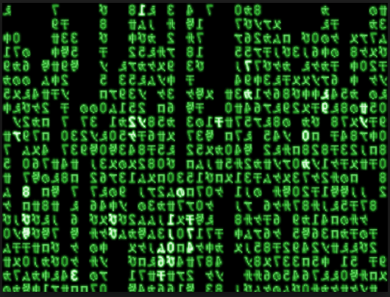
Thank You!
Twitter - @NerdworkNerd_
Blog – http://blog.thenetworknerd.com
Podcast - http://nerd-journey.com
Notes:
Special thanks to…
Pete Koehler
Max Abelardo
Rich Bean
AJ Ciampa

